Slide 1
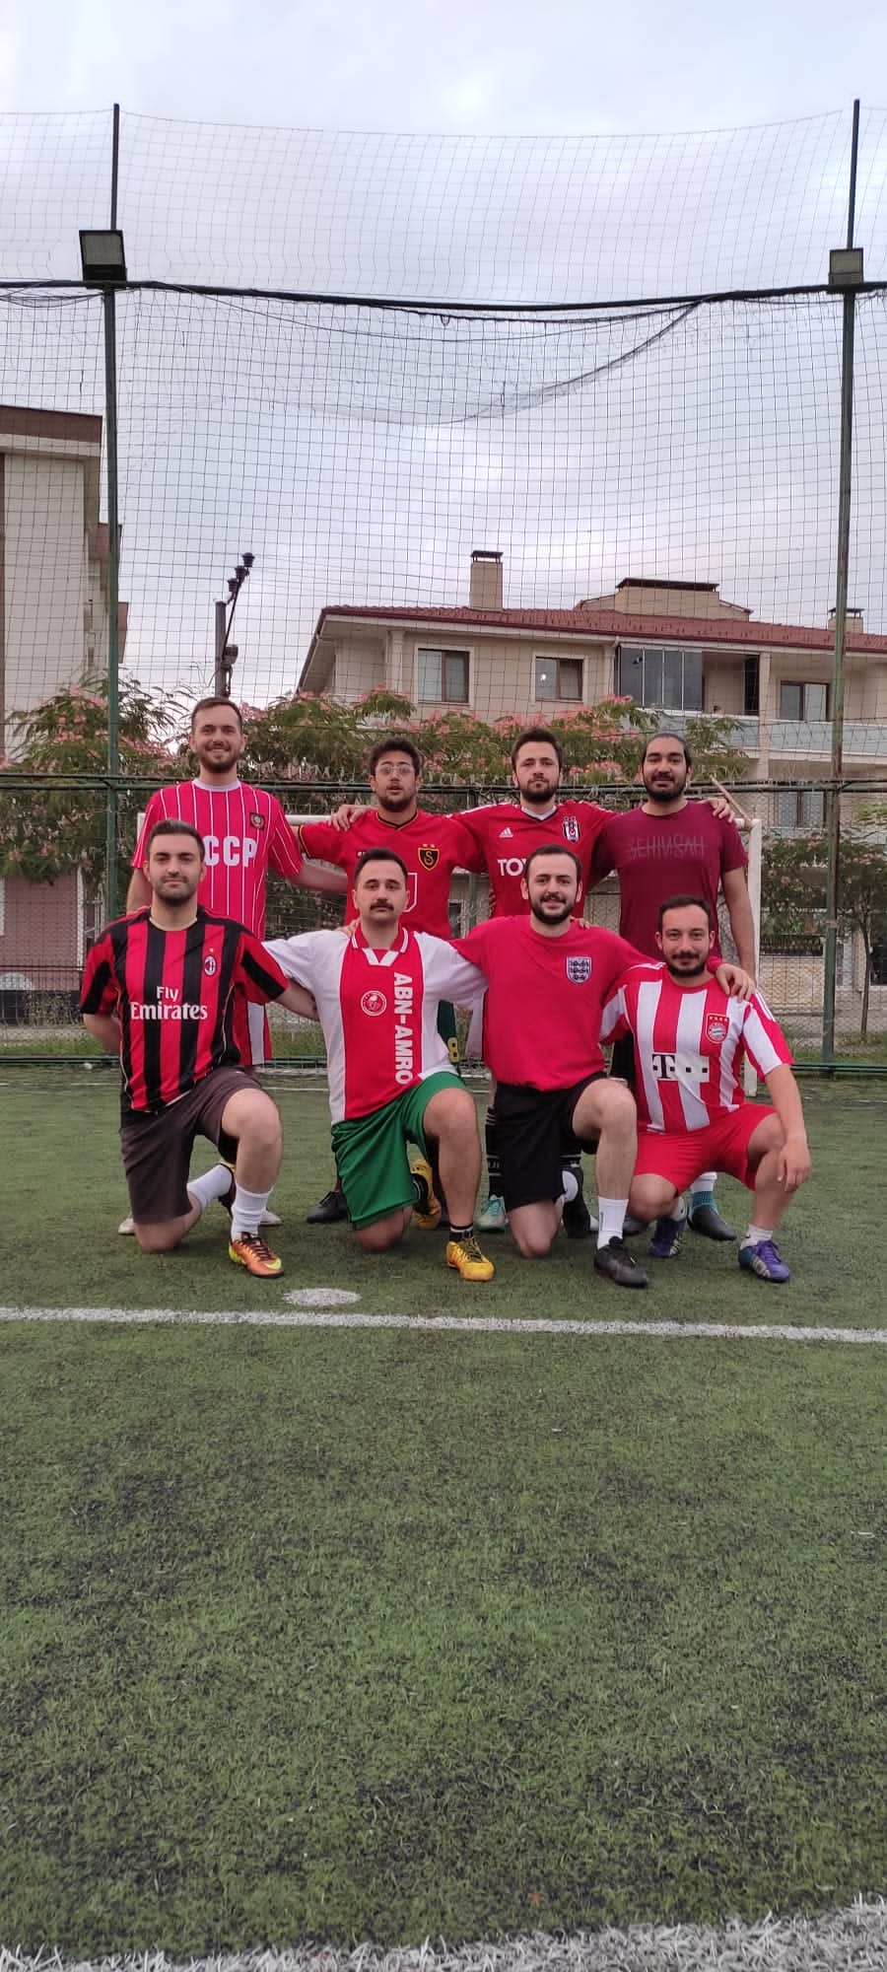

Football Player
Dataset Analysis
Levent Ergul

Slide 2



Libraries
Pandas: is a fast, powerful, flexible and easy to use open source data analysis and manipulation tool, built on top of the Python programming language.
Numpy: is a library for the Python programming language, adding support for large, multi-dimensional arrays and matrices, along with a large collection of high-level mathematical functions to operate on these arrays
Seaborn: Seaborn is a data visualization library built on top of matplotlib and closely integrated with pandas data structures in Python. Visualization is the central part of Seaborn which helps in exploration and understanding of data.

Slide 3
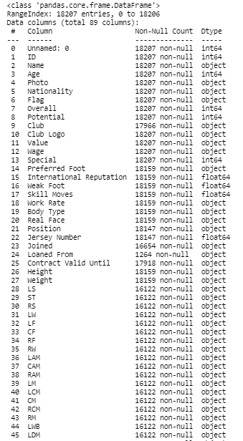
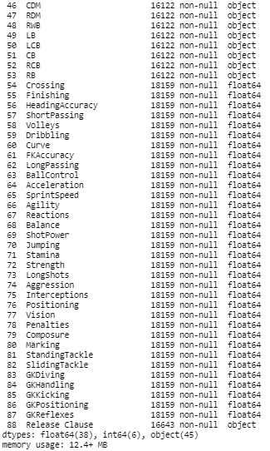
Dataset
General Information
Dataset have 89 features and 18207 examples. Features type is different.
38 variables are float,
6 variables are integer,
45 variables object.

Slide 4
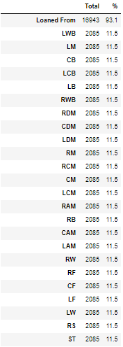
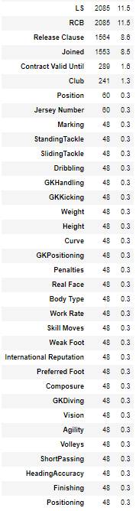
Dataset
Missing Data
One of the most important things is checking the dataset before analyzing it.
Loaned From feature has highest missing values equal to 16943.
Also some features have the missing values. Such as RCM 2085 or Club 241.

Slide 5
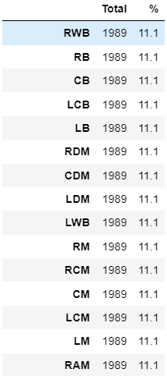
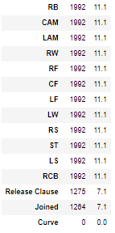
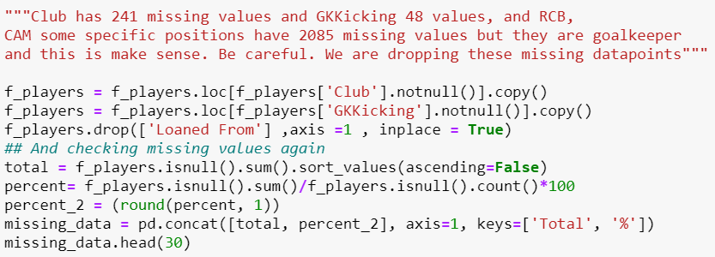
Dataset
Missing Data Elimination

Slide 6
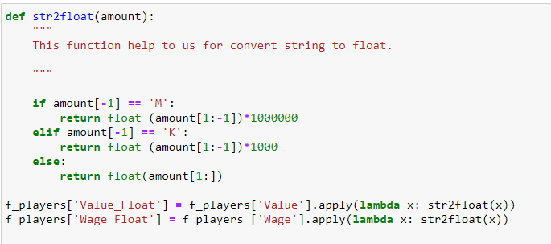
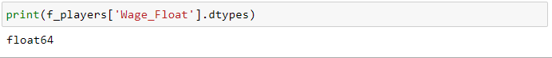
Dataset
Converting some features
Some features in the dataset are in the string. For the analysis part, we need to convert them to float or integer.

Slide 7
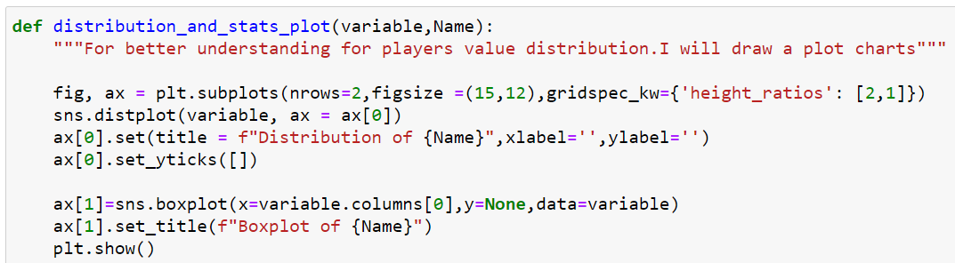
Data Visualization
Create Function
In this part, we will look at some features distribution. I will create functions to implementation for these features.
This function is suited for the integer variables.

Slide 8
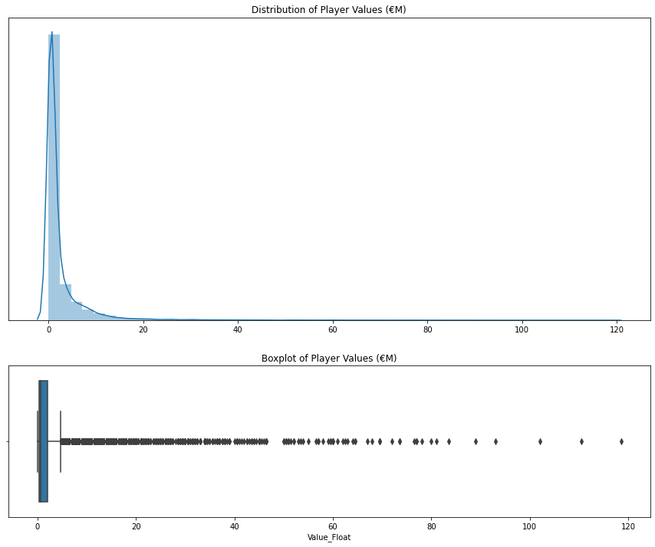
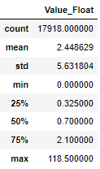
Data Visualization
Market Values
Players generally have low market value and for this reason, we can not see general the distribution of that. High prices players are almost not seeing on the chart. For that, we can use a logarithmic distribution chart, which shows us more clearly.

Slide 9
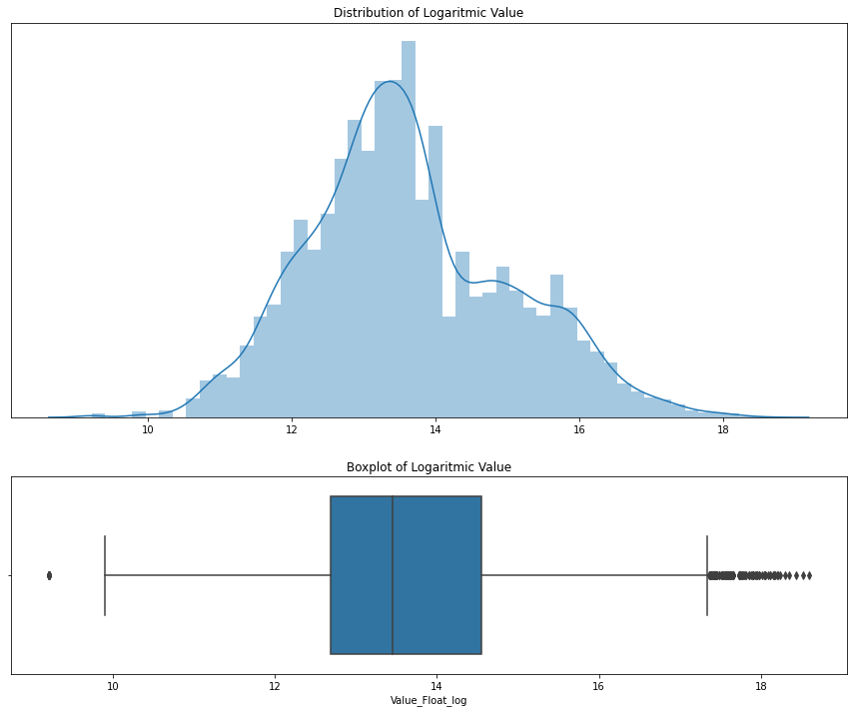
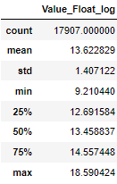
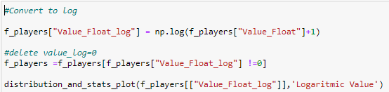
Data Visualization
Market Values
There are 11 values equal to 0 in our dataset, which is why we can delete these variables. They are not affecting too much.

Slide 10
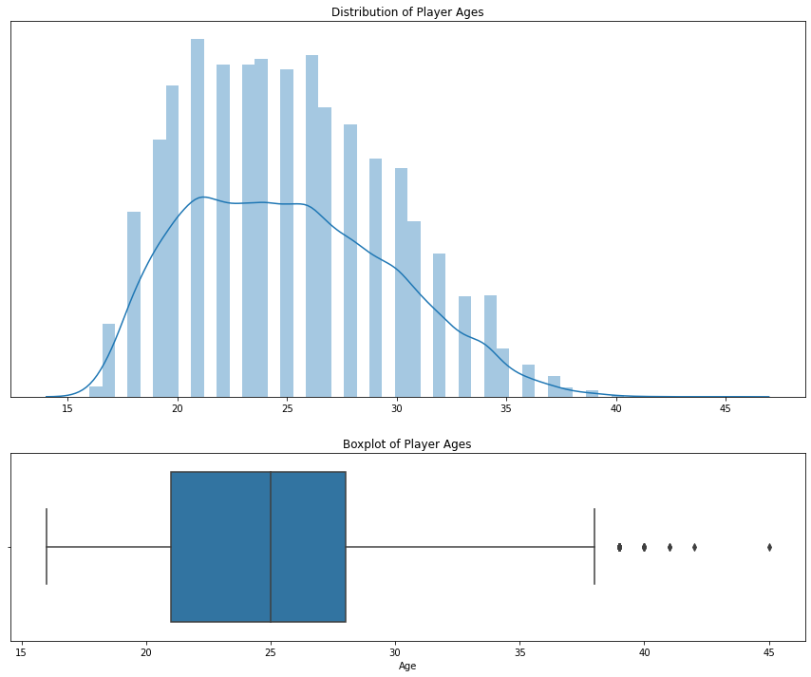
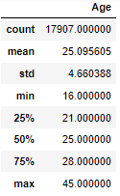
Data Visualization
Age
The age of each player.

Slide 11
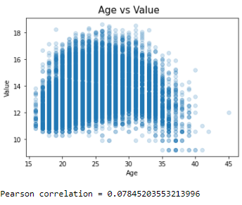
Data Visualization
Age vs Market Value
There seems to be slight positive correlation between age and value.
When the player age is approximately >35 then the values tend to decline.

Slide 12
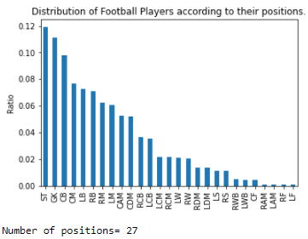
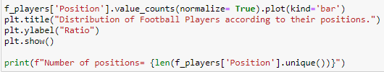
Data Visualization
Position
In this step we will examine distribution of the players position.

Slide 13
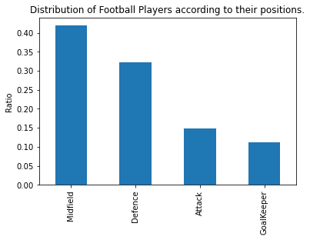
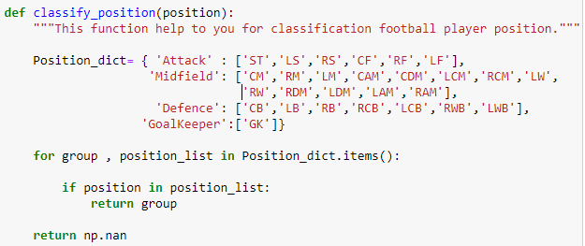
Data Visualization
Position
In this step, I'll classify the players' positions. Such as Attacker, midfielder, defender and goalkeeper. I will create a function for this.

Slide 14
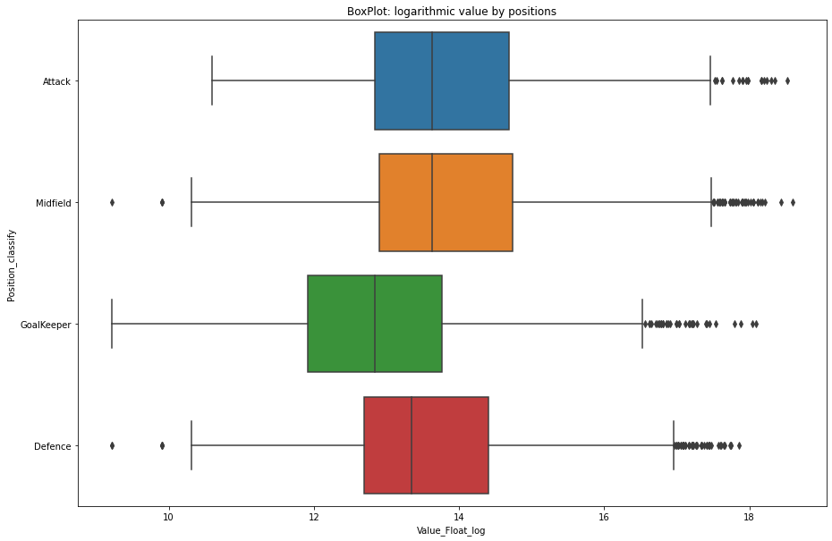
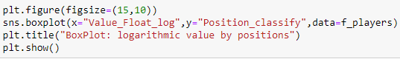
Data Visualization
Position vs Market Value

Slide 15
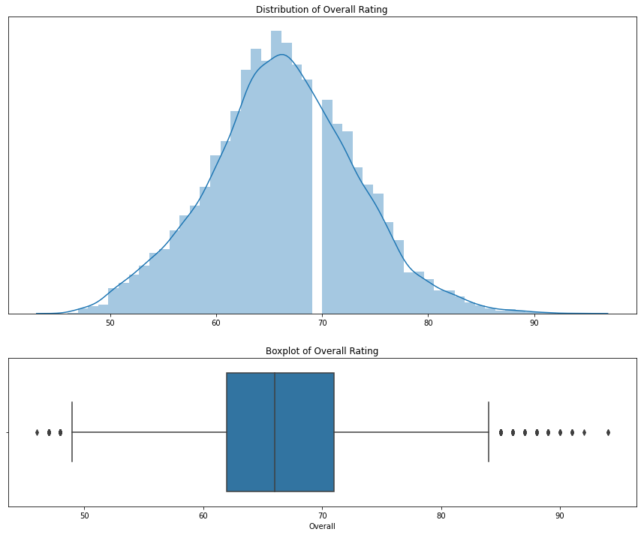
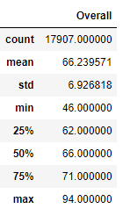
Data Visualization
Overall Rating
Notes:
Overall rating is normally distributed with a average of 66, minimum 46 and maximum 94.

Slide 16
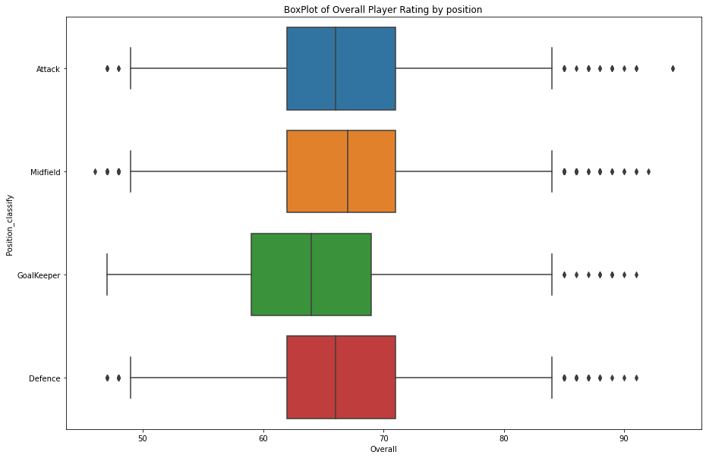
Data Visualization
Overall Rating vs Position
Goalkeepers less overall rating.
Others are similar to each ones.
Notes:
Except for Goalkeepers, other position more or less has the same overall rating. This interesting because as we see before on the logarithmic value by positions chart attackers and midfielders market value higher than the others.

Slide 17
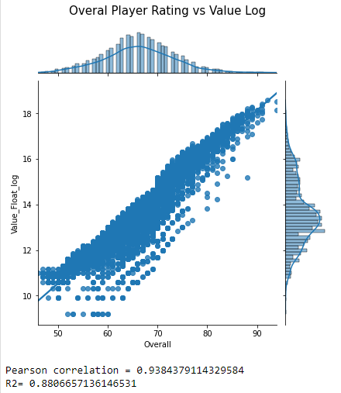
Data Visualization
Overall Rating vs Value
Overall rating is highly correlated with log value with an R2 of 0.89 and is likely to be the most predictive feature.
Notes:
Overall rating is highly correlated with log value with an R2 of 0.89 and is likely to be the most predictive feature.

Slide 18
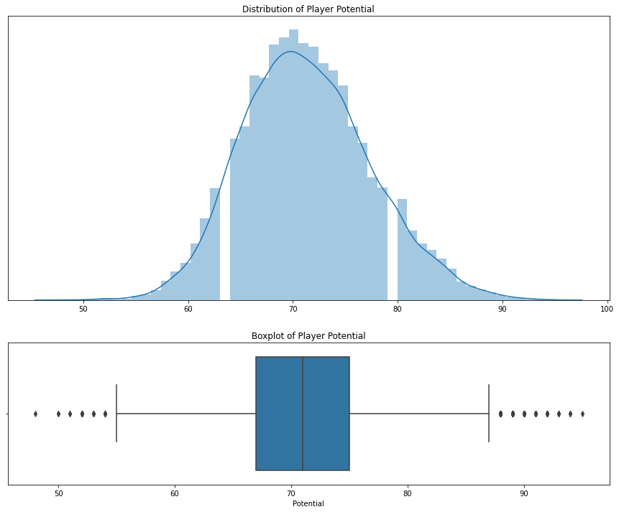
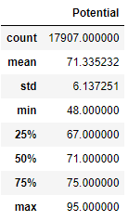
Data Visualization
Potential Rating

Slide 19
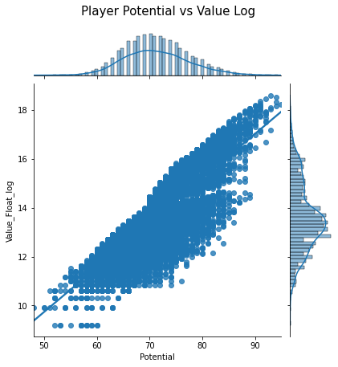
Data Visualization
Potential Rating vs Market Value
If a player has high potential it also has high market values.

Slide 20
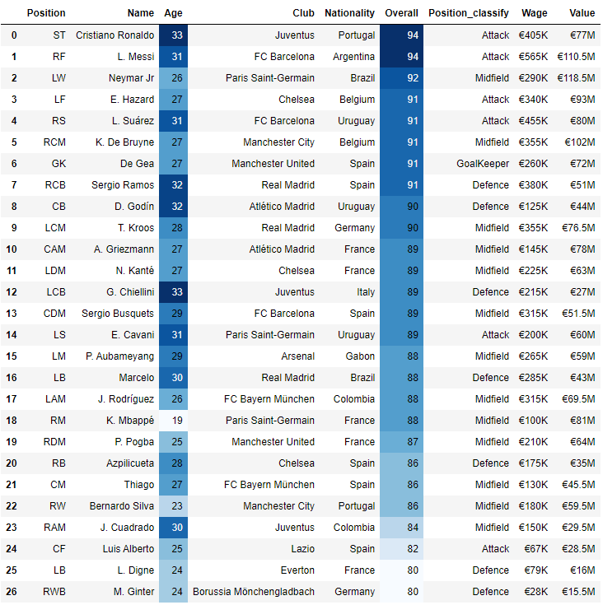
Data Visualization
Best Player for each Position
Except for the Aubameyang, all of them are from Europe or America(South).

Slide 21
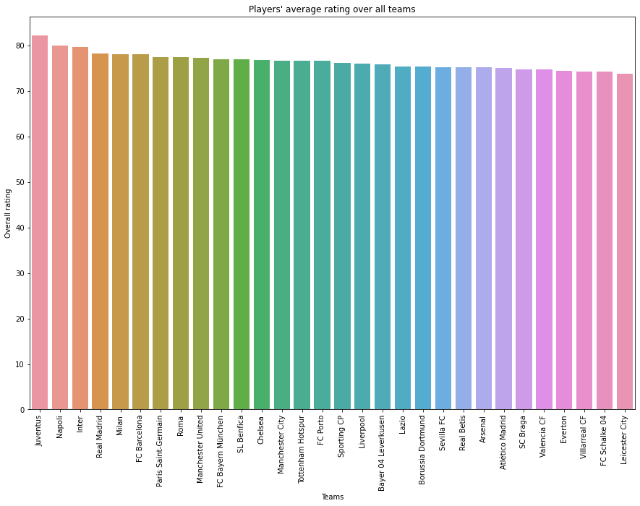
Data Visualization
Club Teams Overall
This plot show us top 30 teams according to their average rating.

Slide 22
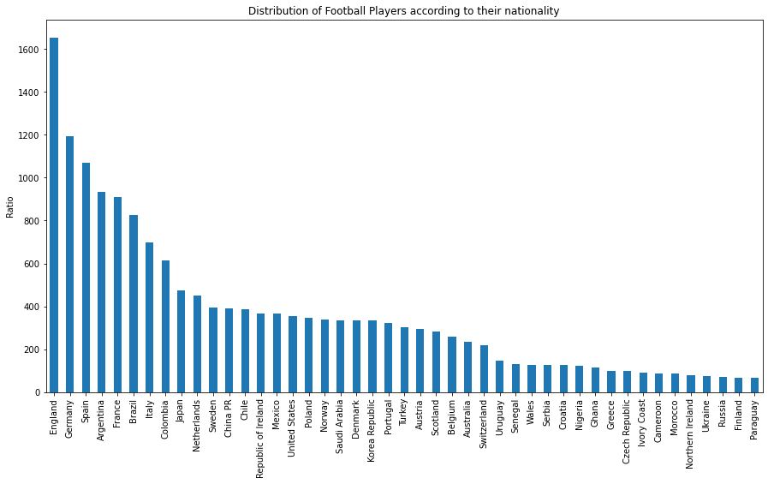
Data Visualization
Nationality
Number of countries = 43
This number is a lot, we can classify country like their region. Such as Europe, America etc.

Slide 23
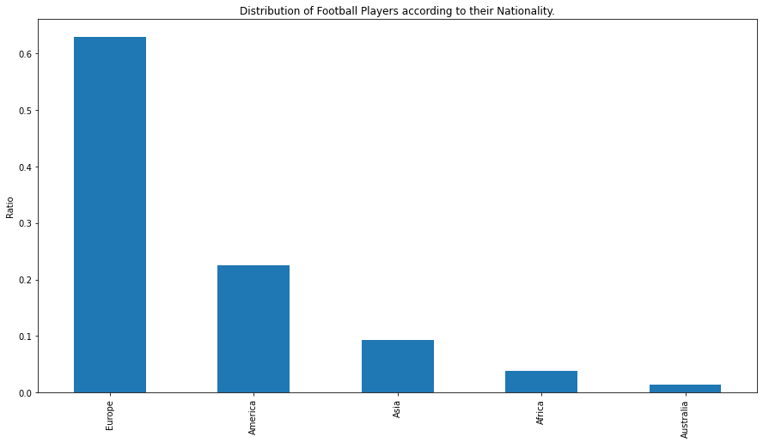
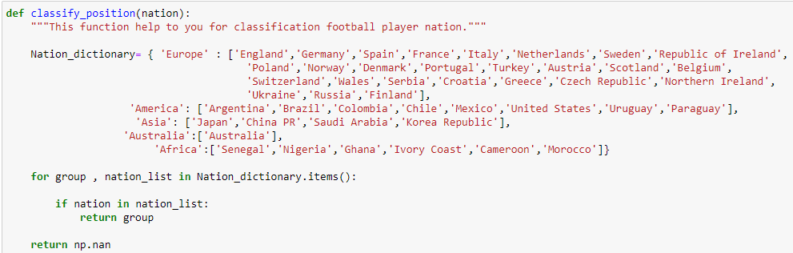
Data Visualization
Nationality

Slide 24
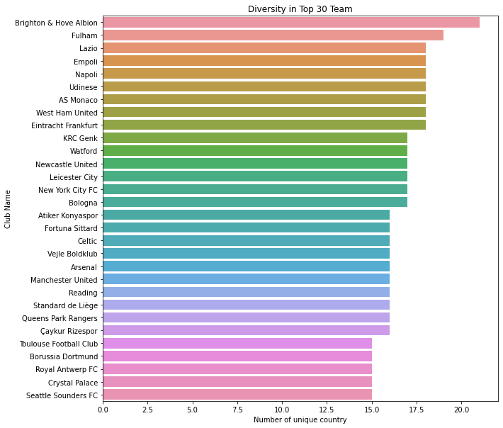
Data Visualization
Diversity in Club Teams
Average of players from different nationalities in teams: 7.86
Number of unique club teams: 651

Slide 25
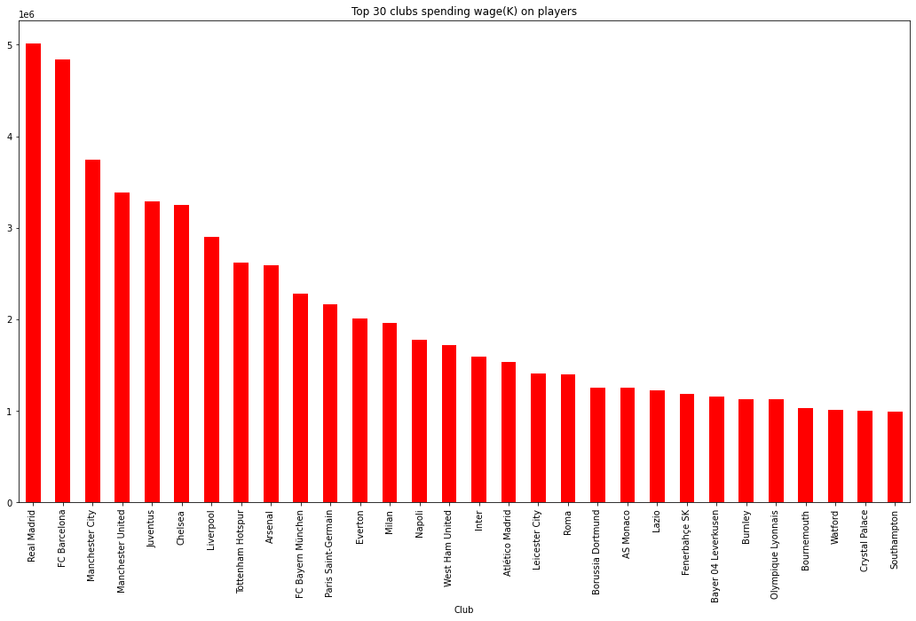
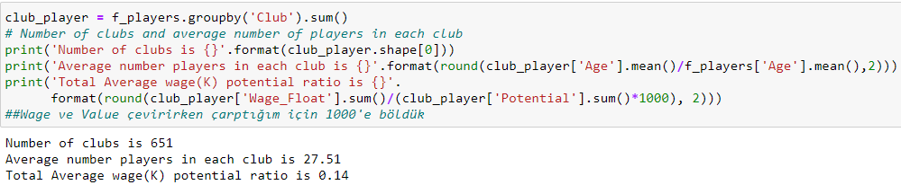
Data Visualization
Wage

Slide 26
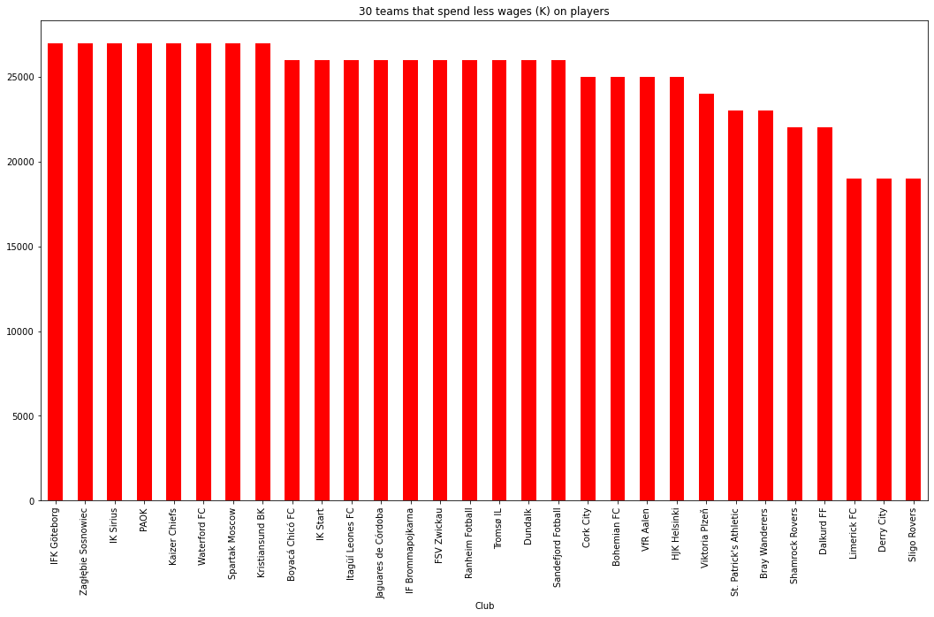
Data Visualization
Wage
This plot shows us the last 30 teams in spending money for football players.

Slide 27
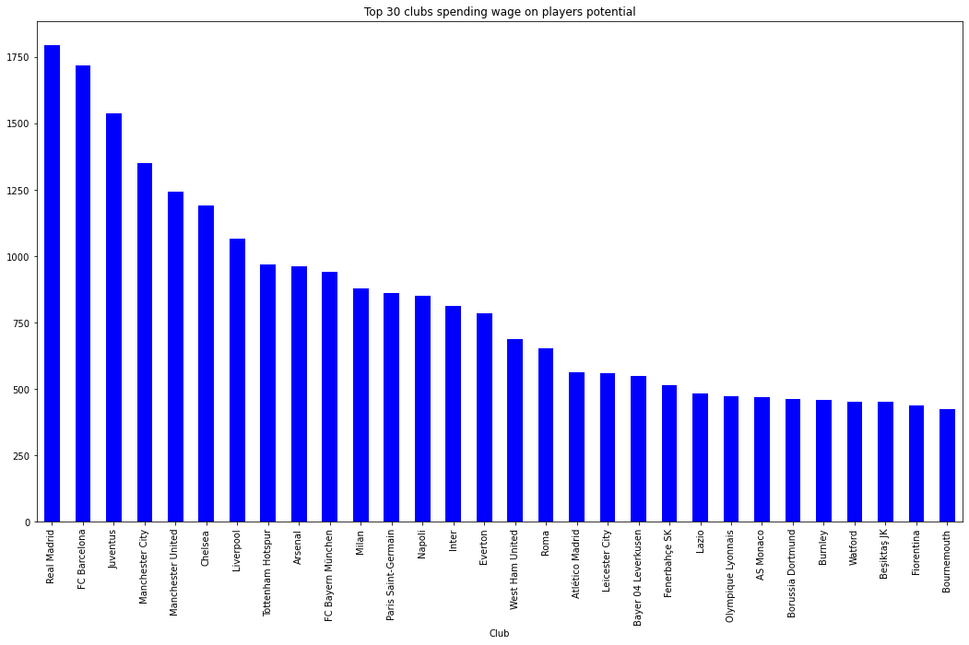
Data Visualization
Wage vs Potential
This plot shows us the top 30 teams in spending money for football players.

Slide 28
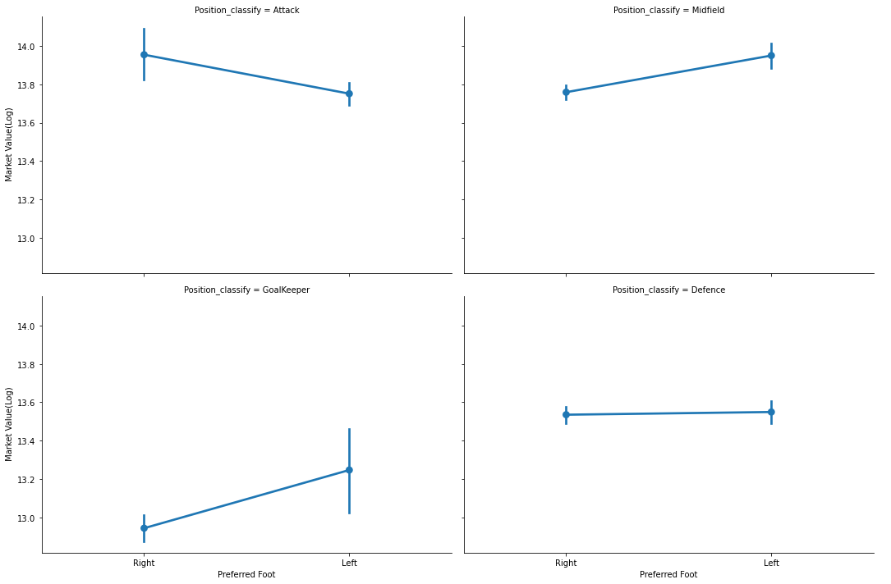
Data Visualization
Preferred Foot vs Value

Slide 29
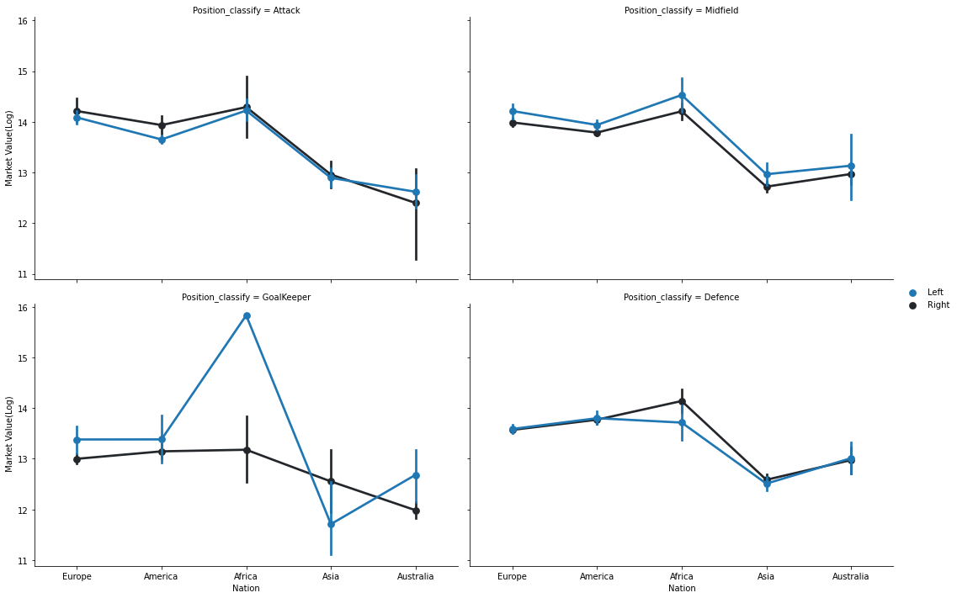
Data Visualization
Preferred Foot - Value -
Nationality

Slide 30
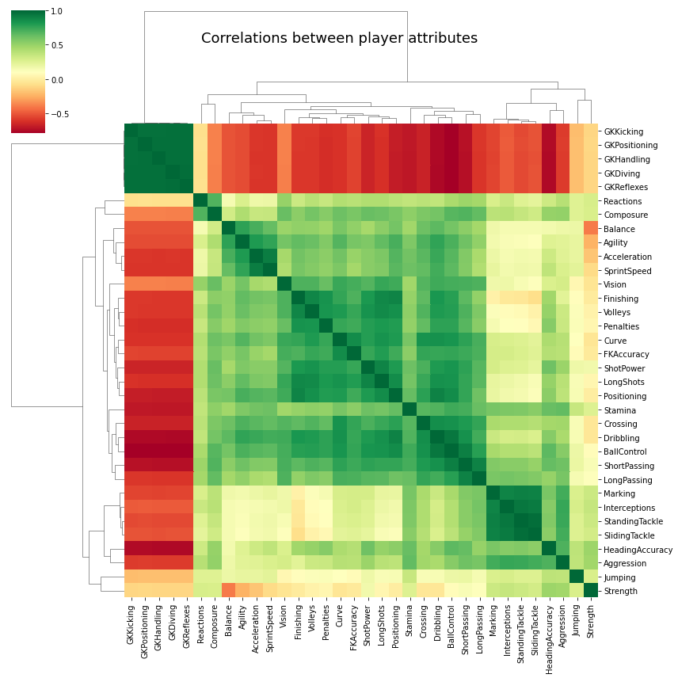
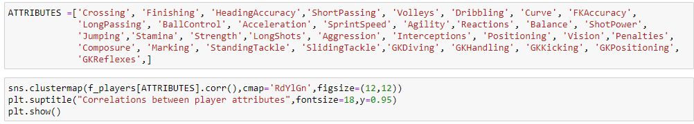
Data Visualization
Correlation
Notes:
There are a number of highly correlated features. Most notably, the goalkeeping attributes (GK kicking, GK positioning, GK handling, GK diving and GK reflexes) are very correlated with each other and negatively correlated with the outfield attributes. Outfield attributes are generally all correlated with each other. Defending attributes (Marking, interceptions, standing tackle, sliding tackle etc) are very correlated with each other, however, the attacking attributes are not as strongly correlated. This shows that generally, goal keepers and defenders have a set of 'standard' skills whereas the attacking players have more specific skills sets (e.g. particularly good at volleying or crossing but not necessarily both.

Slide 31
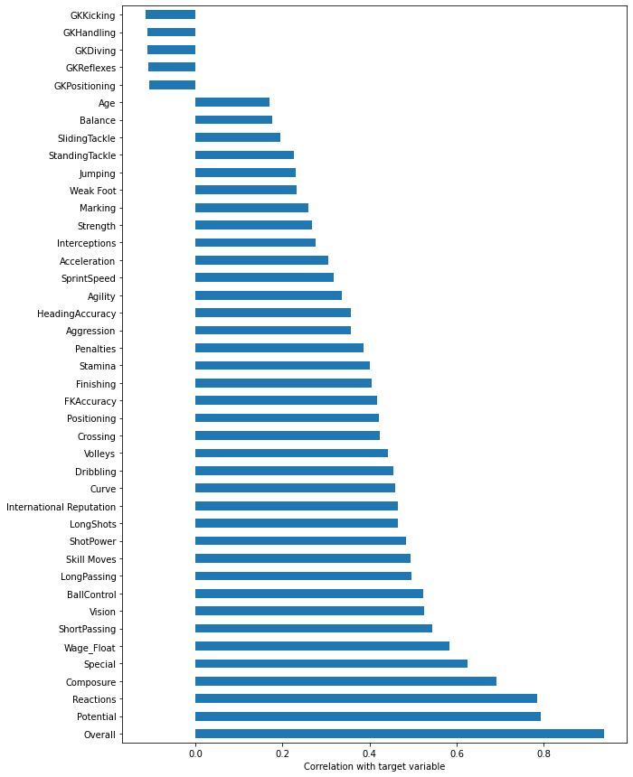
Data Visualization
Feature Importance
Feature Correlations to the target variable, log(Value_Float)

Slide 32


